Slide 1

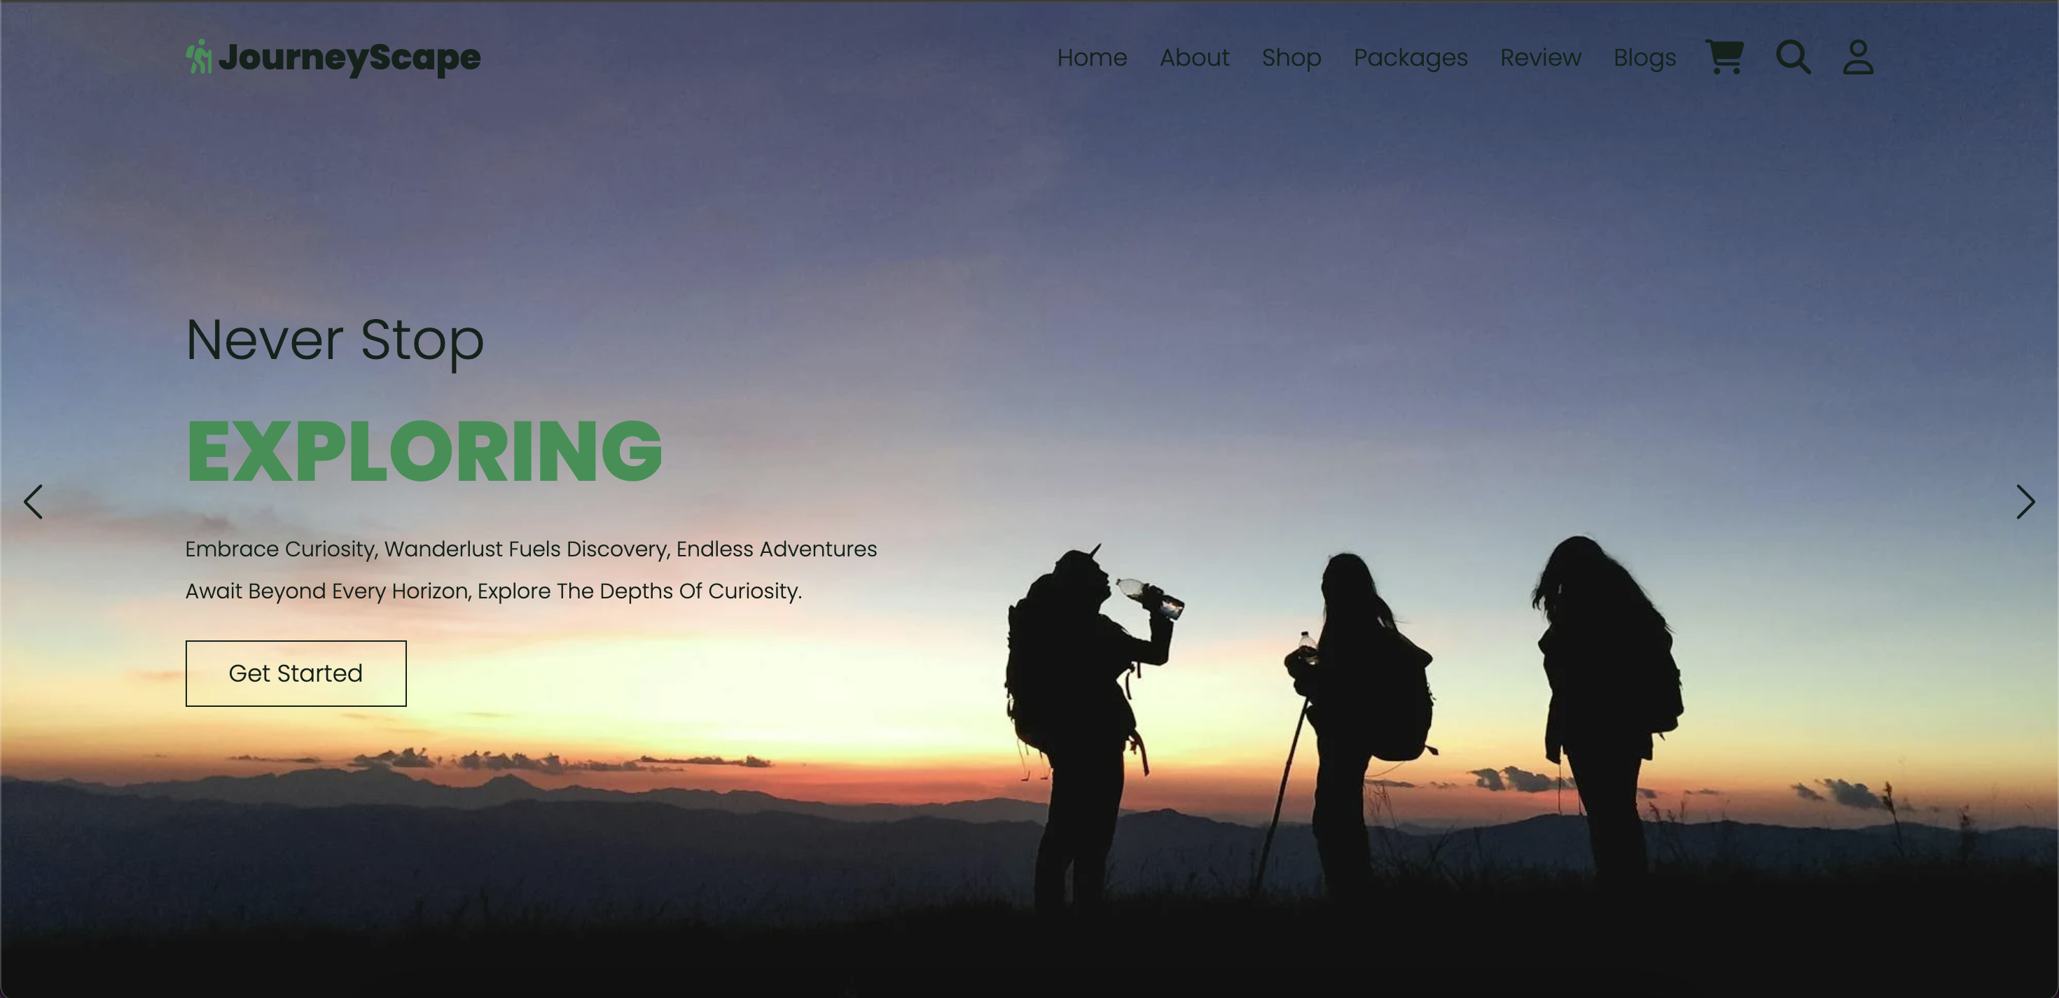
Travel Website Project Presentation
Course Code: INT-219
Created by
Tirtharaj Barma 12218232 Roll No. 22 Section: KM071

Slide 2
Introduction
Project Overview
Key Features
Technologies Used
This project aims to develop a dynamic travel website showcasing various travel destinations and packages. The website will include
1. sections for user interaction, 2. shopping, and 3. information.
The website will feature an About Page providing detailed information about the company and its services, a Packages Section showcasing various travel packages, a Shop Section for travel accessories and essentials, a Review Section for user feedback, and a Blog Section for travel tips and stories.
The website is developed using 1. HTML, 2. CSS, and 3. JavaScript to ensure an interactive and visually appealing user experience.

Slide 3
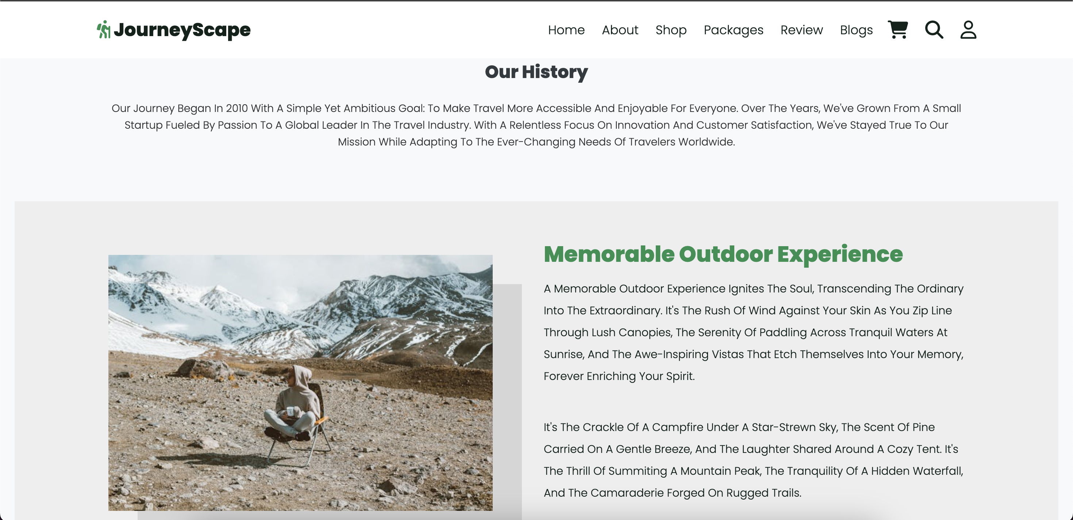
About Page
Description
The About Page serves as an introduction to the travel company, providing an overview of its history, mission, and values. It also includes information about the team and the company's commitment to responsible tourism.
Photos provided by Pexels

Slide 4
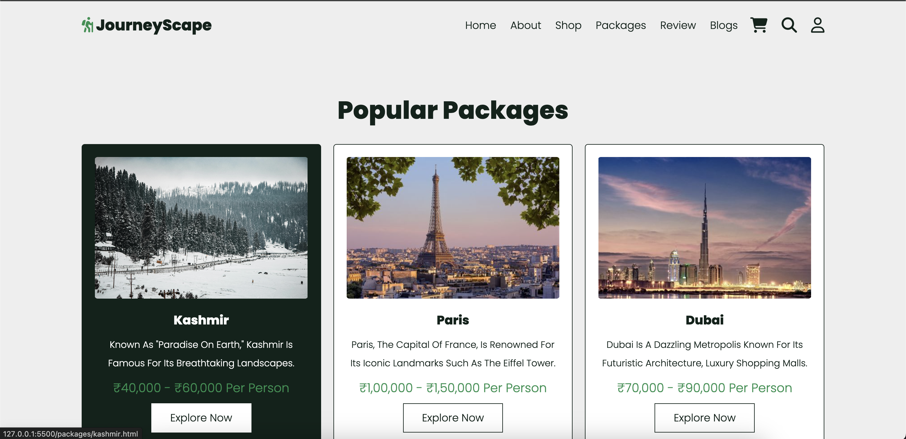
Packages Section
Description
The Packages Section displays various travel packages offered by the company, each with detailed information about destinations, itineraries, and inclusions. Users can explore, select, and customize their preferred travel packages.
Photos provided by Pexels

Slide 5
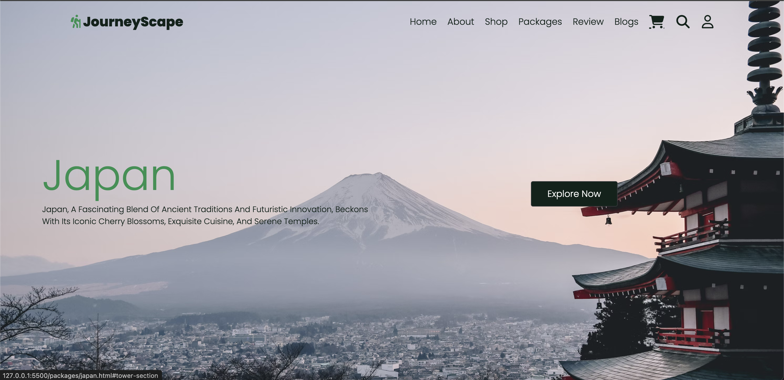
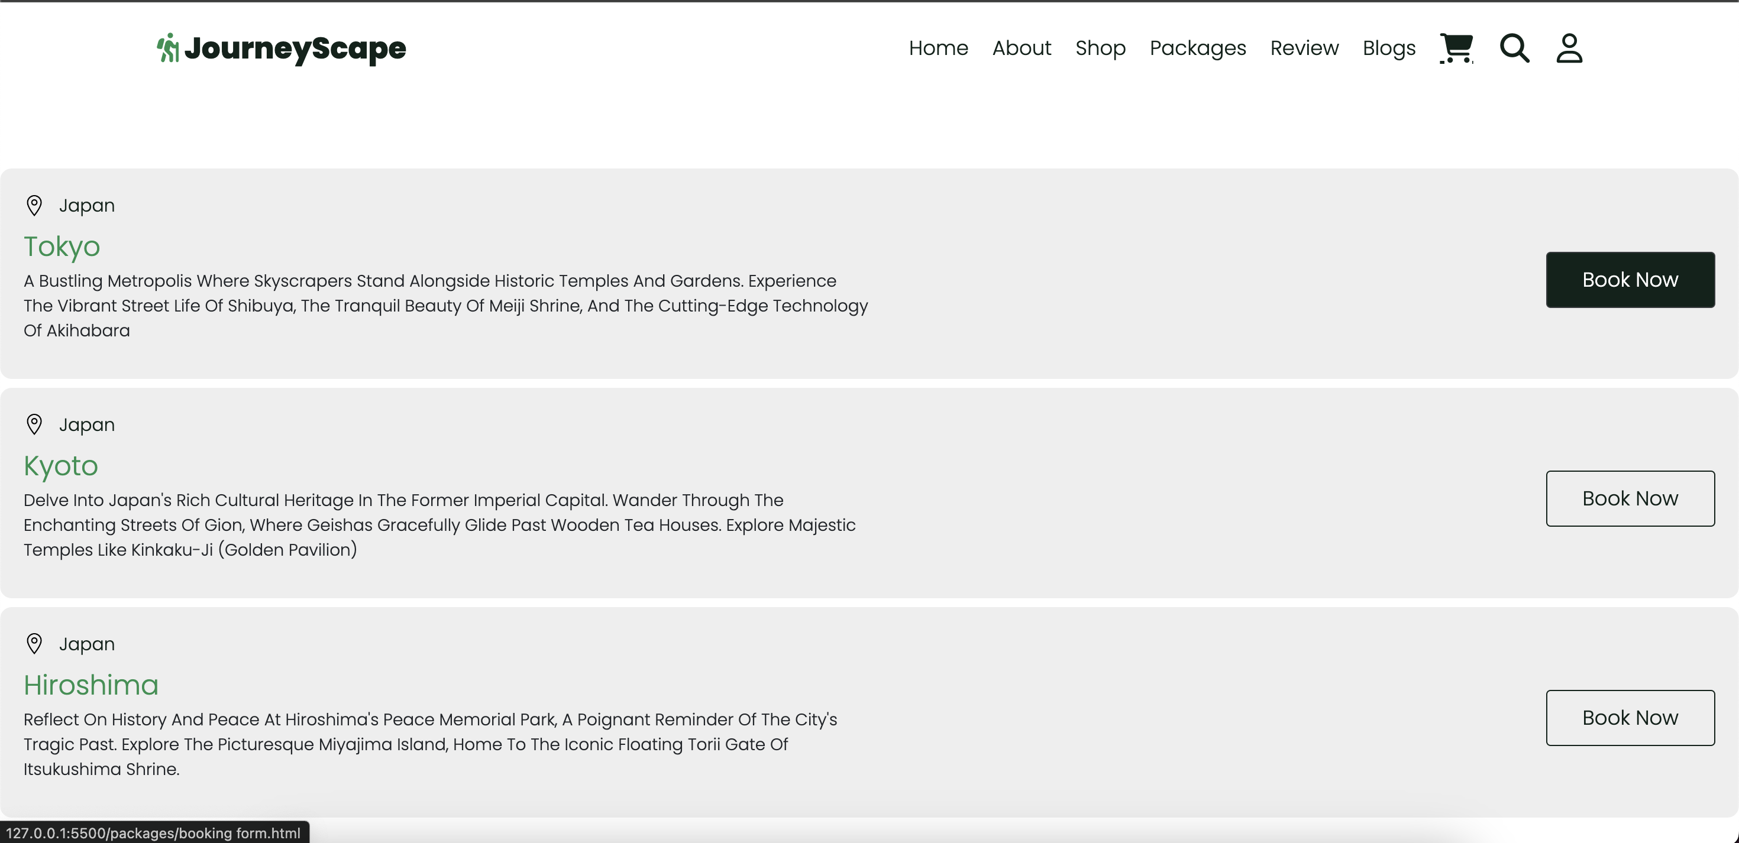
Packages Section
Description
The Packages Section displays various travel packages offered by the company, each with detailed information about destinations, itineraries, and inclusions. Users can explore, select, and customize their preferred travel packages.
Photos provided by Pexels

Slide 6
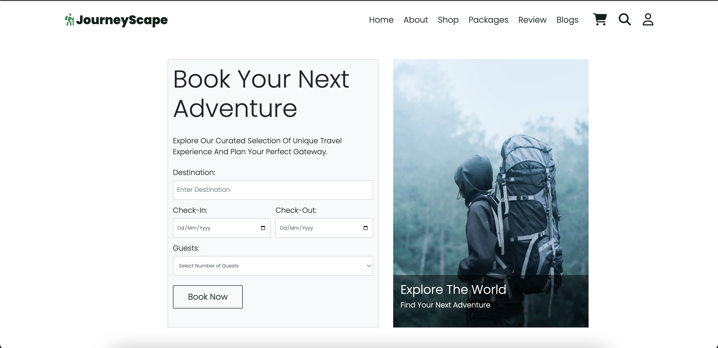
Packages Section
Description
The Packages Section displays various travel packages offered by the company, each with detailed information about destinations, itineraries, and inclusions. Users can explore, select, and customize their preferred travel packages.
Photos provided by Pexels

Slide 7
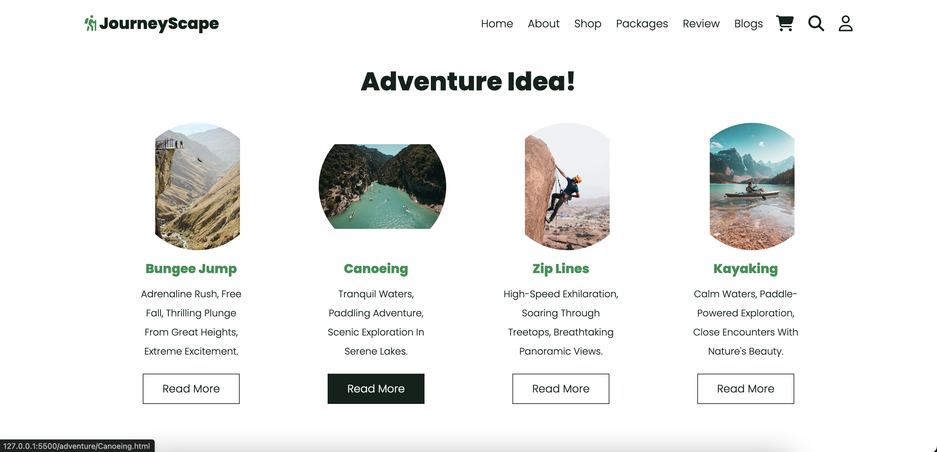
Activity Section
Description
The Activity Section displays various travel packages offered by the company, each with detailed information about destinations, itineraries, and inclusions. Users can explore, select, and customize their preferred travel packages.
Photos provided by Pexels

Slide 8
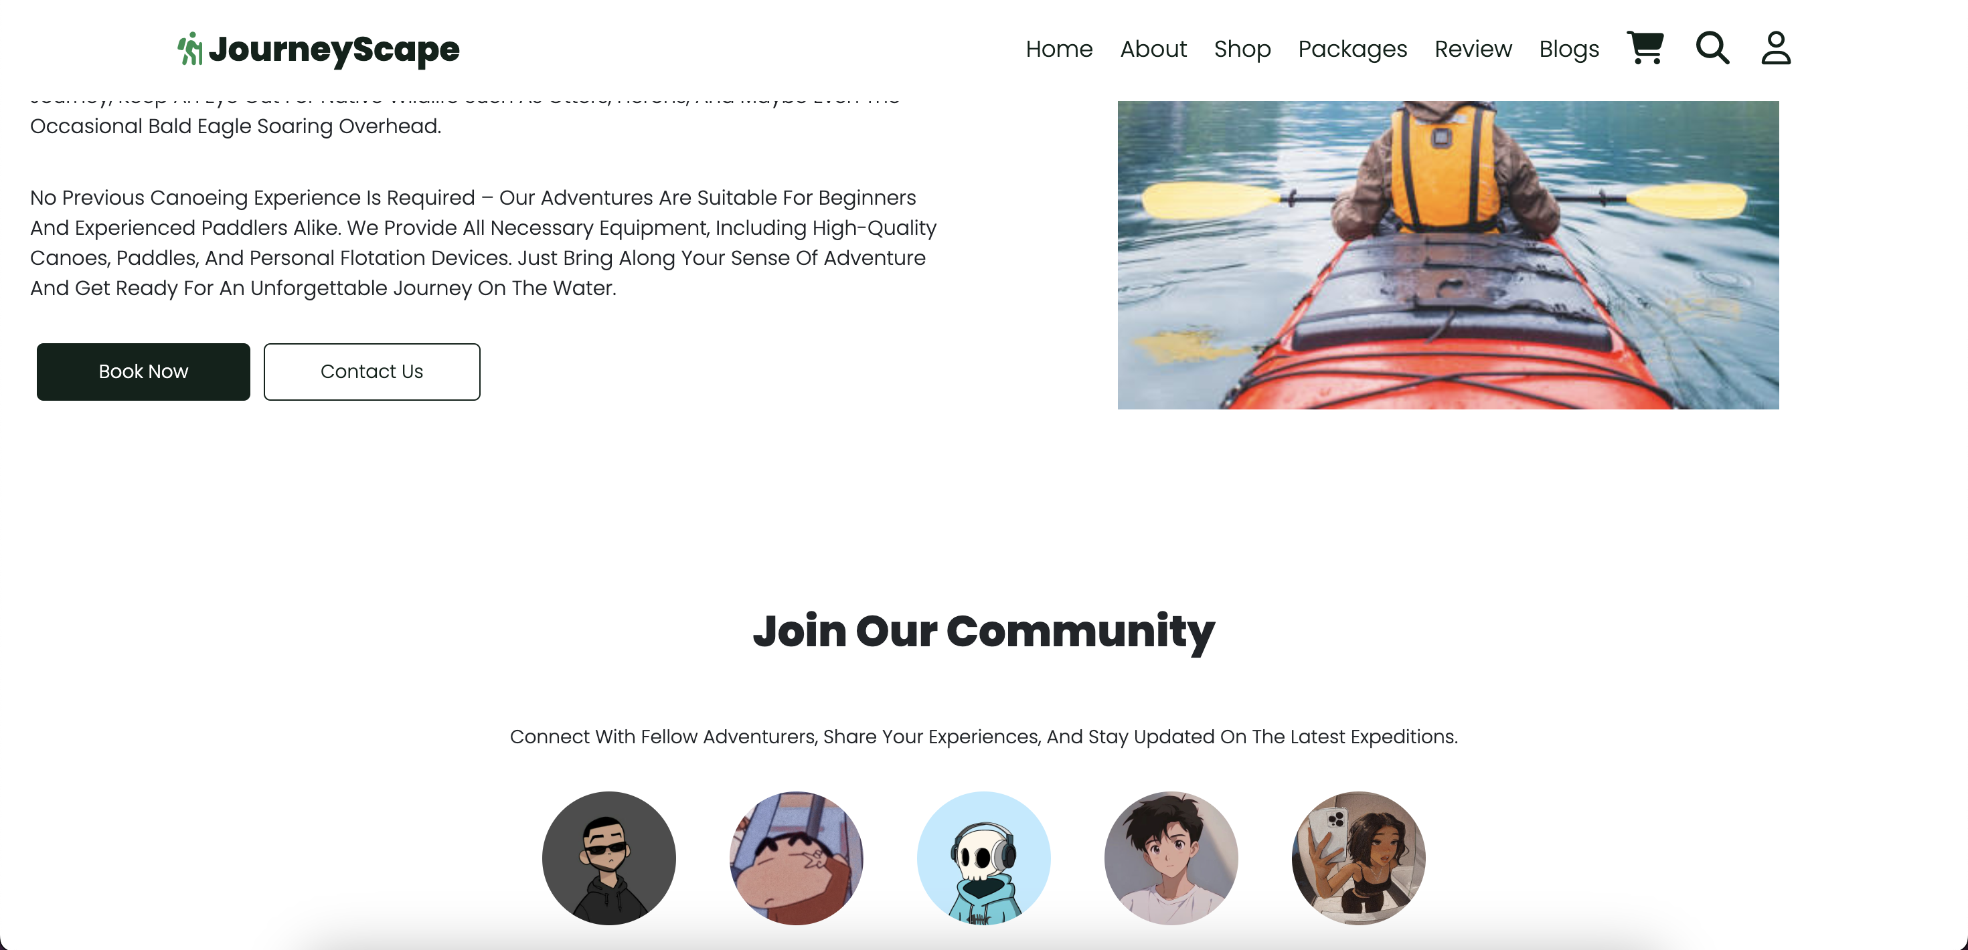
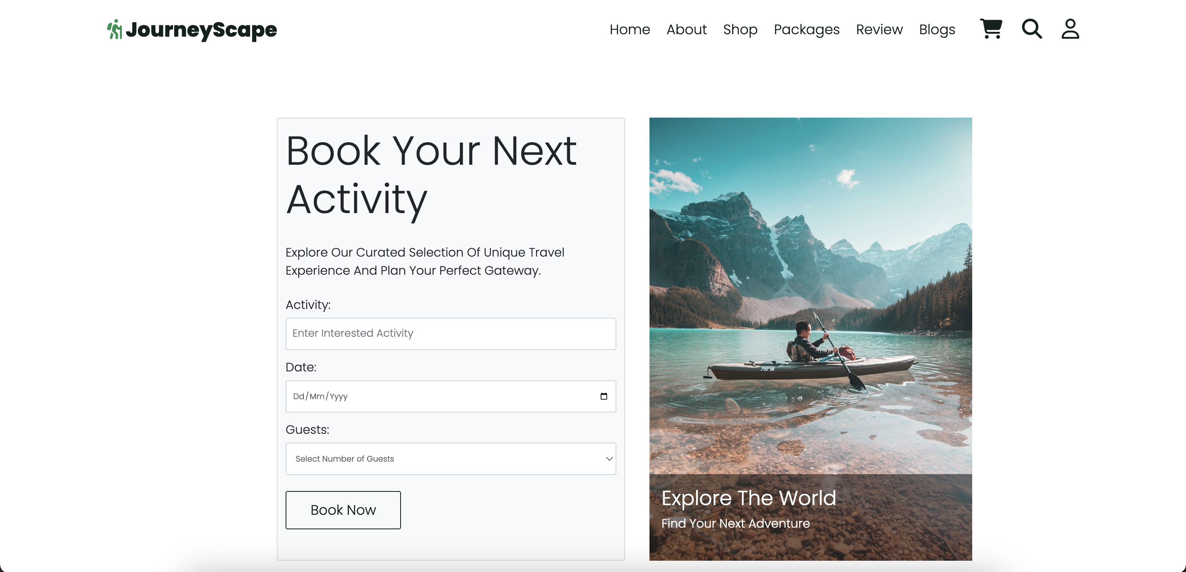
Activity Section
Description
The Activity Section displays various travel packages offered by the company, each with detailed information about destinations, itineraries, and inclusions. Users can explore, select, and customize their preferred travel packages.
Photos provided by Pexels

Slide 9
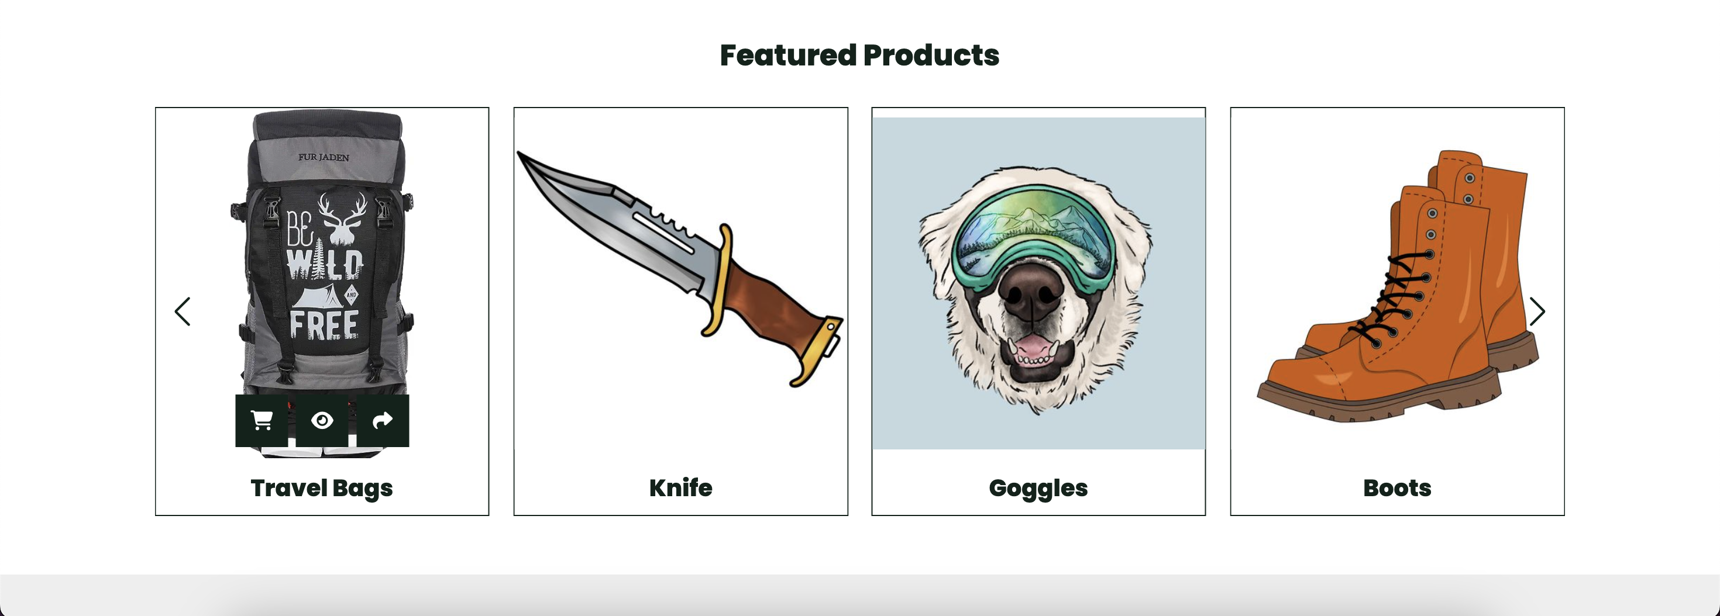
Shop Section
Description
The Shop Section provides a platform for users to purchase travel essentials such as luggage, clothing, and accessories. It offers a convenient and integrated e-commerce experience for travelers to acquire necessary items for their trips.
used swiper.js Library
Photos provided by Pexels

Slide 10
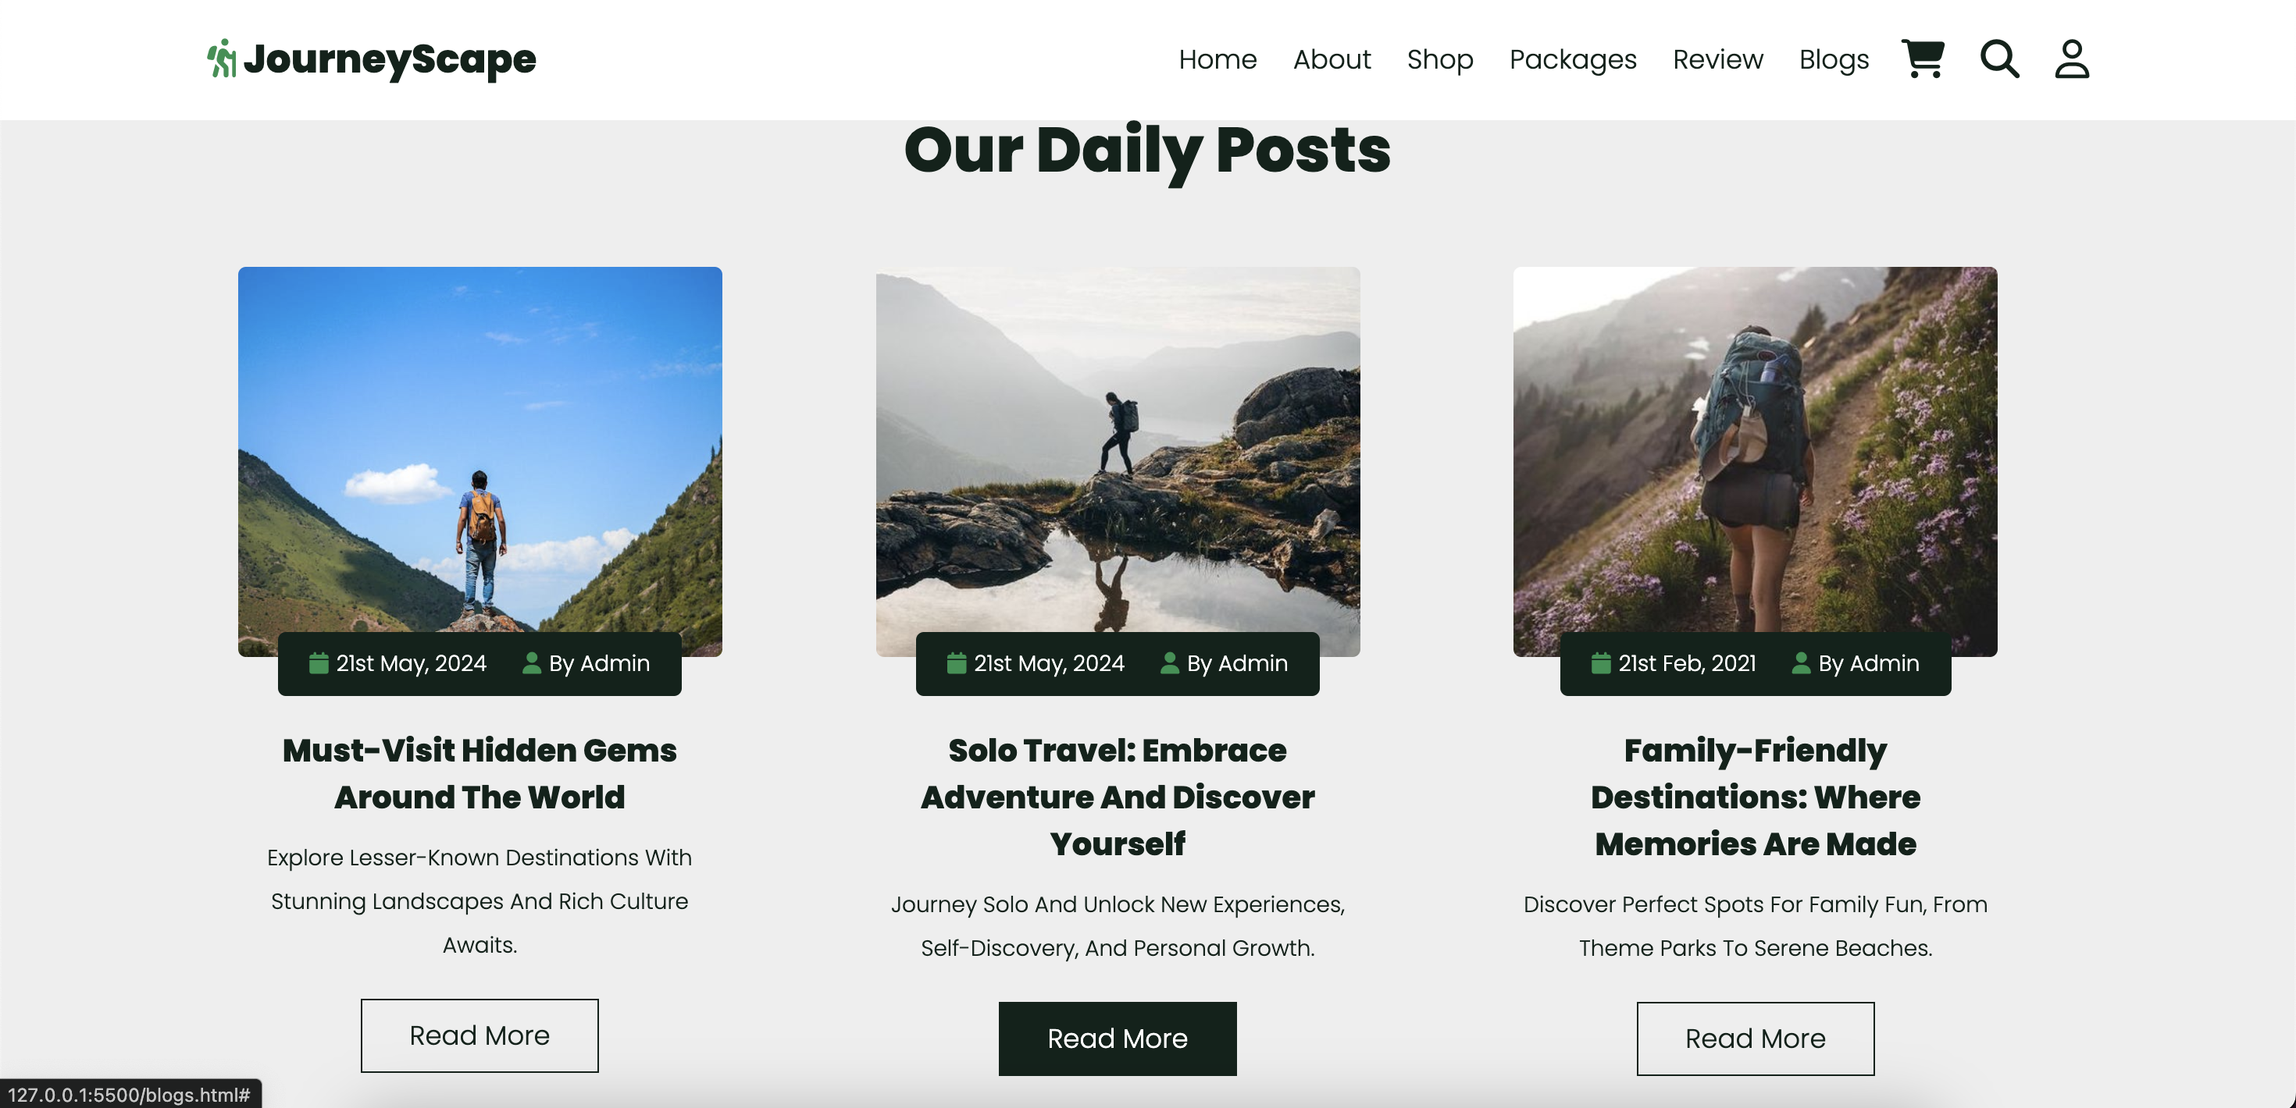
Blog Section
Description
The Blog Section features engaging travel articles, tips, and inspiring stories to enhance the user's travel knowledge and experience.
Photos provided by Pexels

Slide 11
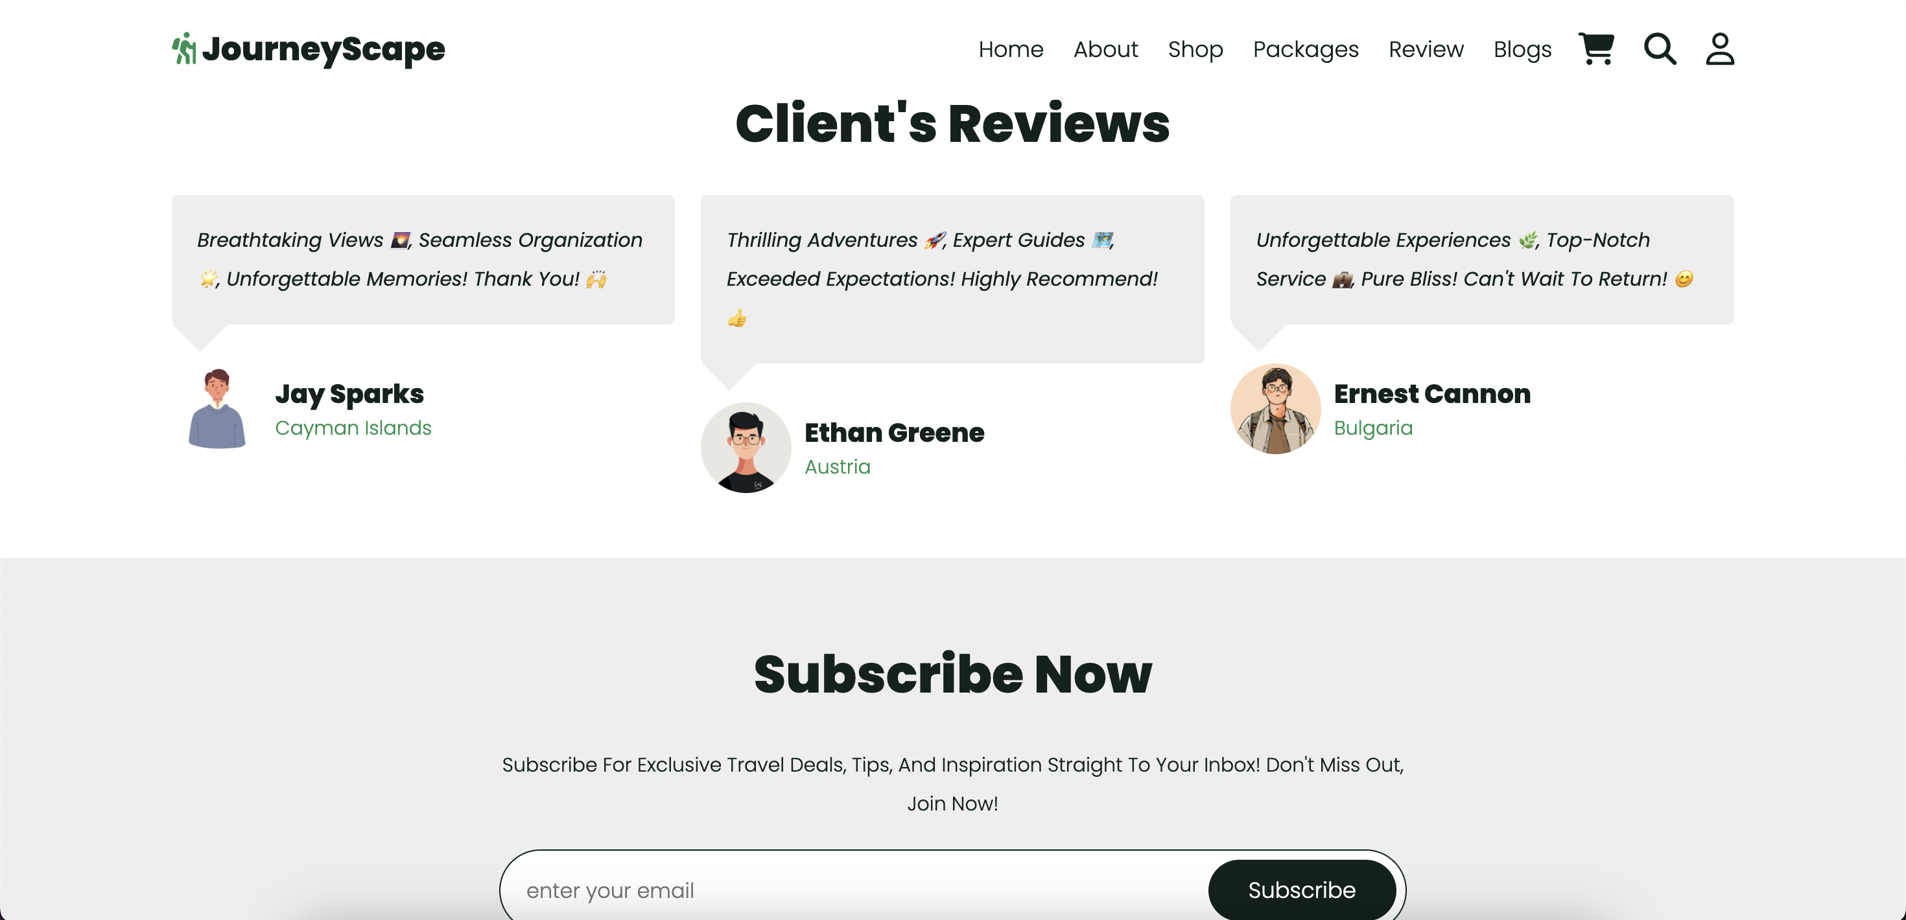
Review
Description
The Review Section allows users to share their travel experiences and provide feedback on the services. The
used swiper.js Library
Photos provided by Pexels

Slide 12
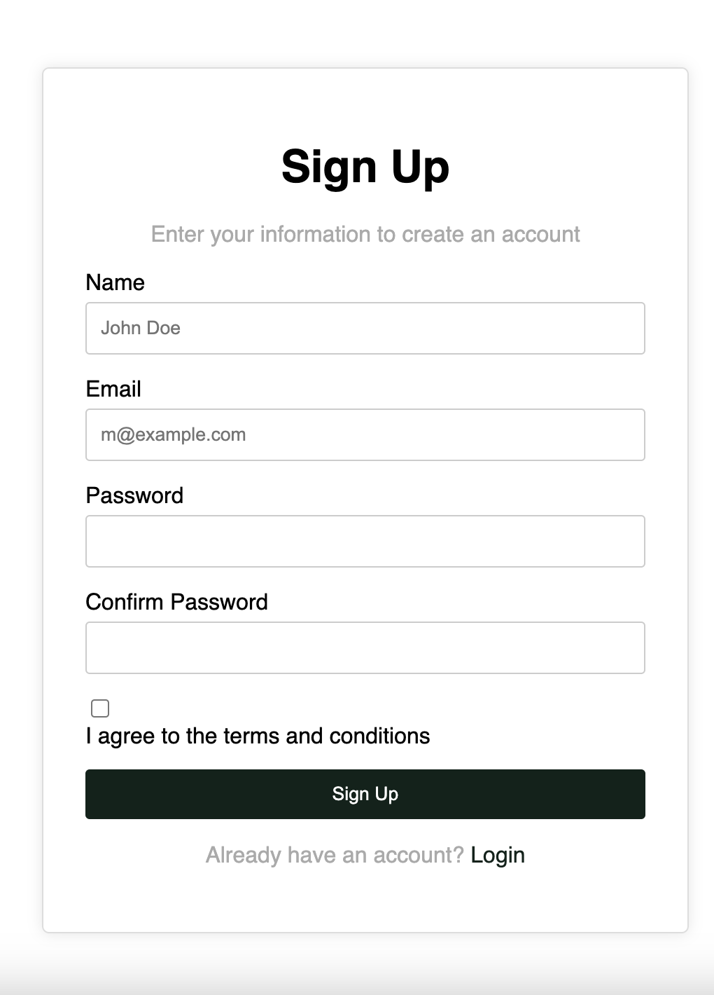
Registration and Login Page
Description
The Registration and Login Page powered by Angular provides users with secure access to their accounts, allowing them to manage bookings, access personalized recommendations, and interact with the website's community features.
Photos provided by Pexels

Slide 13
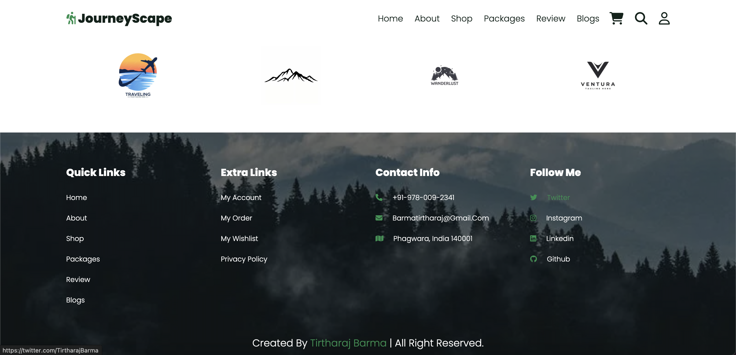
Footer
Description
All the related information contact details and navbar settings
Photos provided by Pexels

